Slide 1
DECODER
&
ENCODER
Presented By
Name | ID
MD. SHOHANUR RAHMAN SHOHAN | 22-46013-1
A. F. M. RAFIUL HASSAN | 22-47048-1

Slide 2
INTRODUCTION
The decoder & encoder both are a combinational device or a circuit. The encoder will convert the information from one format to another format i.e like electrical signals to counters or a PLC. The feedback signal of the encoder will determine the position, count, speed, and direction. The control devices are used to send the command to a particular function. The decoder is a circuit used to change the code into a set of signals. The name its self tells the decoder because it has the reverse of encoding. The decoders are very simple to design.

Slide 3
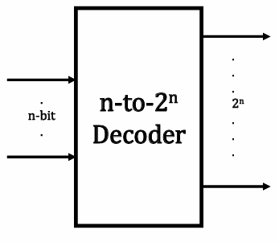
DECODER
A n-to-2^{n} decoder takes an n-bit input and produces 2^{n} outputs.
The n-bit inputs represent a binary number that determines which of the 2n outputs is uniquely true.
As the name suggest the job of the decoder is to decode.
A decoder is commonly used in address decoding.

Slide 4
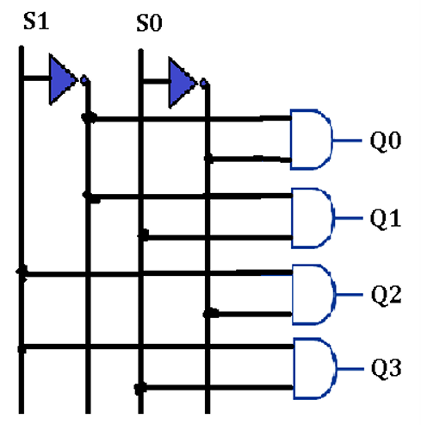
2 – to 4 Line Decoder
Number of input is 2
Number of output is 4
Truth Table:
S0 | S1 | Q0 | Q1 | Q2 | Q3
0 | 0 | 1 | 0 | 0 | 0
0 | 1 | 0 | 1 | 0 | 0
1 | 0 | 0 | 0 | 1 | 0
1 | 1 | 0 | 0 | 0 | 1

Slide 5
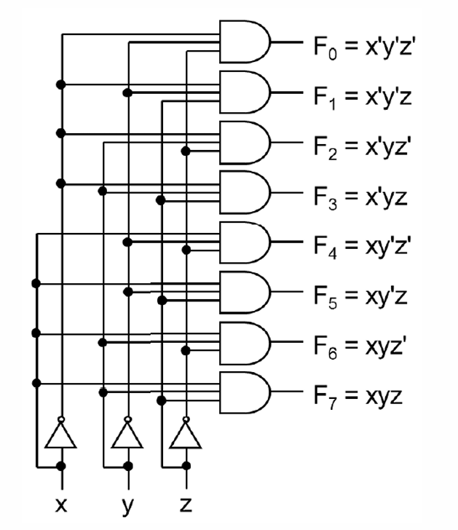
3 – to 8 Line Decoder
Number of input is 3
Number of output is 8
Truth Table:
X | Y | Z | F₀ | F₁ | F₂ | F₃ | F₄ | F₅ | F₆ | F₇
0 | 0 | 0 | 1 | 0 | 0 | 0 | 0 | 0 | 0 | 0
0 | 0 | 1 | 0 | 1 | 0 | 0 | 0 | 0 | 0 | 0
0 | 1 | 0 | 0 | 0 | 1 | 0 | 0 | 0 | 0 | 0
0 | 1 | 1 | 0 | 0 | 0 | 1 | 0 | 0 | 0 | 0
1 | 0 | 0 | 0 | 0 | 0 | 0 | 1 | 0 | 0 | 0
1 | 0 | 1 | 0 | 0 | 0 | 0 | 0 | 1 | 0 | 0
1 | 1 | 0 | 0 | 0 | 0 | 0 | 0 | 0 | 1 | 0
1 | 1 | 1 | 0 | 0 | 0 | 0 | 0 | 0 | 0 | 1

Slide 6
Decoder Applications
Decoders are used for code conversions.
Decoders are extensively used in memory systems of computers.
Decoders are also used for de-multiplexing or data distribution.
Decoders are also used in data routing applications where very short propagation delay is required.
Decoder may also be used for timing or sequencing purposes.
Decoders are also utilized to turn on and off digital devices at a specific time.

Slide 7
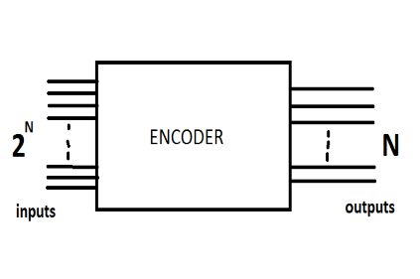
ENCODER
An Encoder is a combinational logic circuit that performs a “reverse” decoder functions.
As the name suggests its function is to encode an input signal.
An encoder accepts an active level on one of its input and outputs the coded output for the input.
Generally an encoder has 2^{n} inputs and n-outputs.
There can be a variety of encoders, but we will only keep ourselves to binary encoders.

Slide 8
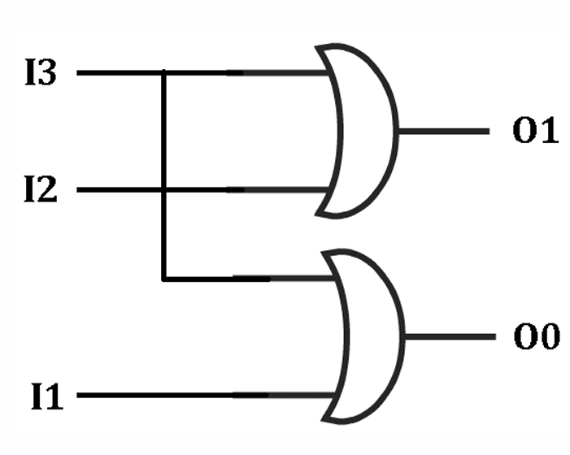
4 – to 2 Line Encoder
Number of input is 4
Number of output is 2
Truth Table:
I₃ | I₂ | I₁ | I₀ | O₁ | O₀
0 | 0 | 0 | 1 | 0 | 0
0 | 0 | 1 | 0 | 0 | 1
0 | 1 | 0 | 0 | 1 | 0
1 | 0 | 0 | 0 | 1 | 1
Since we have only these 4-combinations in the ideal case, the Boolean expressions are:
𝐎_{𝟎} =𝐈_{𝟏}+𝐈_{𝟑}
𝐎_{𝟏} =𝐈_{𝟐}+𝐈₃

Slide 9
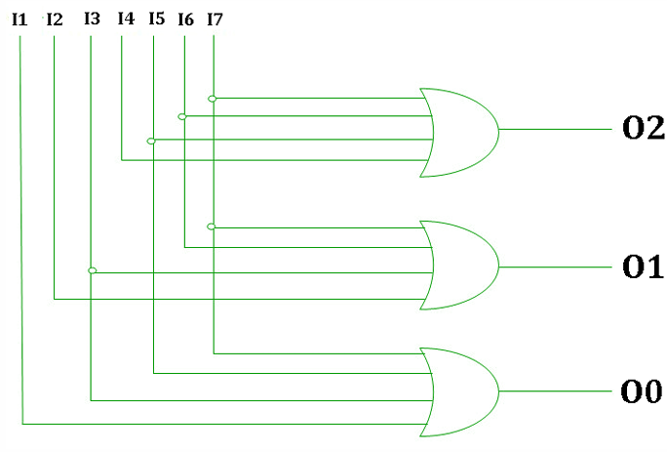
8 – to 3 Line Encoder
Number of input is 8
Number of output is 3
Truth Table:
I₇ | I₆ | I₅ | I₄ | I₃ | I₂ | I₁ | I₀ | O₂ | O₁ | O₀
0 | 0 | 0 | 0 | 0 | 0 | 0 | 1 | 0 | 0 | 0
0 | 0 | 0 | 0 | 0 | 0 | 1 | 0 | 0 | 0 | 1
0 | 0 | 0 | 0 | 0 | 1 | 0 | 0 | 0 | 1 | 0
0 | 0 | 0 | 0 | 1 | 0 | 0 | 0 | 0 | 1 | 1
0 | 0 | 0 | 1 | 0 | 0 | 0 | 0 | 1 | 0 | 0
0 | 0 | 1 | 0 | 0 | 0 | 0 | 0 | 1 | 0 | 1
0 | 1 | 0 | 0 | 0 | 0 | 0 | 0 | 1 | 1 | 0
1 | 0 | 0 | 0 | 0 | 0 | 0 | 0 | 1 | 1 | 1
Boolean expression:
𝐎_{𝟎} =𝐈_{𝟏}+𝐈_{𝟑}+𝐈_{𝟓}+𝐈_{𝟕}
𝐎_{𝟏} =𝐈_{𝟐}+𝐈_{𝟑}+𝐈_{𝟔}+𝐈_{𝟕}
𝐎_{𝟐} =𝐈_{𝟒}+𝐈_{𝟓}+𝐈_{𝟔}+𝐈₇

Slide 10
Decoder vs Encoder
Decoder | Encoder
The combinational circuits that convert the binary data into 2N output lines are called Decoders. | The combinational circuits that modify the binary data into N output lines are known as Encoders.
In this the output lines are 2n. | In this the output lines are n.
It receives coded binary data as its input. | The implemented signal is considered as actual signal input.
It is mostly utilized in memory chips, microprocessors, and more. | It is utilized in videos, E-mail, and more.
Here, the decoder is situated at the receiving side. | When it comes to the communication mode, the encoder is situated at the transmitting end.
The operating procedure is complex. | The operating procedure is quite simple here.

Slide 11
Conclusion
In conclusion, decoders and encoders are indispensable components in information processing. Decoders enable the interpretation of encoded data for seamless communication, while encoders transform complex information for efficient transmission. Their crucial roles extend to technologies like image recognition and secure communication. The ongoing evolution of encoding and decoding mechanisms holds the promise of exciting developments, shaping the future of data-driven applications. Navigating this dynamic landscape requires a keen understanding and effective utilization of decoders and encoders to unlock unprecedented technological possibilities.

Slide 12
THANK YOU

